Slide 1
Who’s who?
Meet the QCS Hub Team

Slide 2
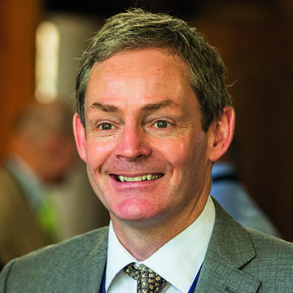
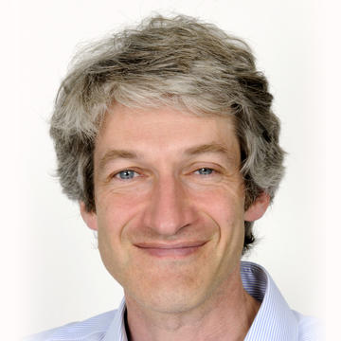
Leadership Team
Professor Dominic O’Brien QCS Hub Director Dominic has two decades of experience in photonic systems integration, including system design, integration process development, and control system development. He was previously Co-Director for Systems Engineering in the Networked Quantum Information Technologies Hub (NQIT), which preceded QCS. | Professor David Lucas Principal Investigator David has a wide range of expertise in experimental quantum physics, including precision measurements, cold atoms, and trapped ions. He is Co-Leader of the Oxford University ion trap quantum computing research group which has realised a full set of one- and two-qubit operations with world-leading performance far surpassing fault-tolerance thresholds. He also leads Oxford’s participation in several European and US projects.

Slide 3
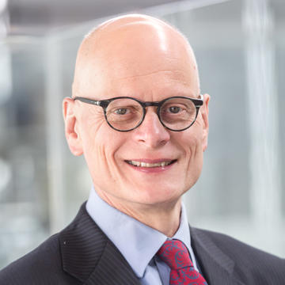
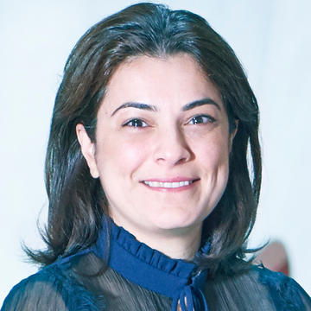
Senior Science Team
Professor Ian Walmsley Ian is Provost of Imperial College London, and Chair in Experimental Physics. His research in optical science and technology ranges from ultrafast optics to quantum information science and he has pioneered quantum photonics for sensing, communication and simulation. He is a Fellow of the Royal Society, the Optical Society (OSA), the American Physical Society, and the Institute of Physics. He was the Director of the Networked Quantum Information Technologies Hub (NQIT), which preceded QCS. | Professor Elham Kashefi Elham is Professor of Quantum Computing at the School of Informatics, University of Edinburgh, and Directeur de recherche au CNRS at LIP6 Sorbonne Universite. She co-founded the fields of quantum cloud computing and quantum computing verification, and has pioneered a trans-disciplinary interaction of hybrid quantum-classical solutions from theoretical investigation all the way to actual experimental and industrial commercialisation (Co-Founder of VeriQloud Ltd). She is the founder of national quantum networks (QuOxIC and QUISCO) and member of multiple institutions (CQIQC in Canada, Li-Fi R&D Centre in Edinburgh, PCQC in France). She served as the Associate Director of the NQIT Hub before being elected to lead the software activities within QCS.

Slide 4
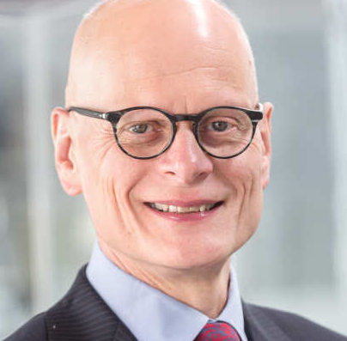
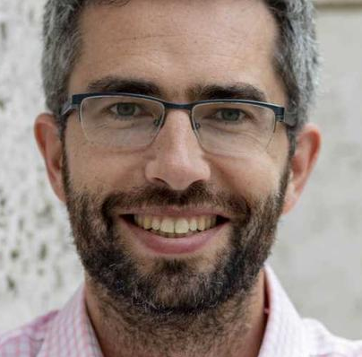
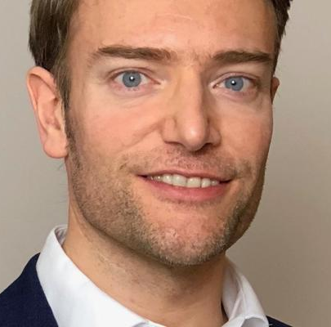

Professor Simon Benjamin Professor of Quantum Technologies, University of Oxford | Professor Noah Linden Professor of Theoretical Physics, University of Bristol
Management Board members
Professor Dominic O’Brien QCS Hub Director, University of Oxford | Professor David Lucas QCS Hub Principal Investigator, University of Oxford | Professor Ian Walmsley Provost, Imperial College London
Professor Elham Kashefi Personal Chair in Quantum Computing, University of Edinburgh | Professor John Morton Director of the UCL Quantum Science and Technology Institute, UCL | Professor Simon Benjamin Professor of Quantum Technologies, University of Oxford | Professor Noah Linden Professor of Theoretical Physics, University of Bristol

Slide 5
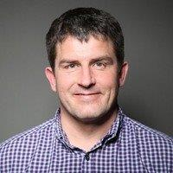
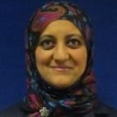
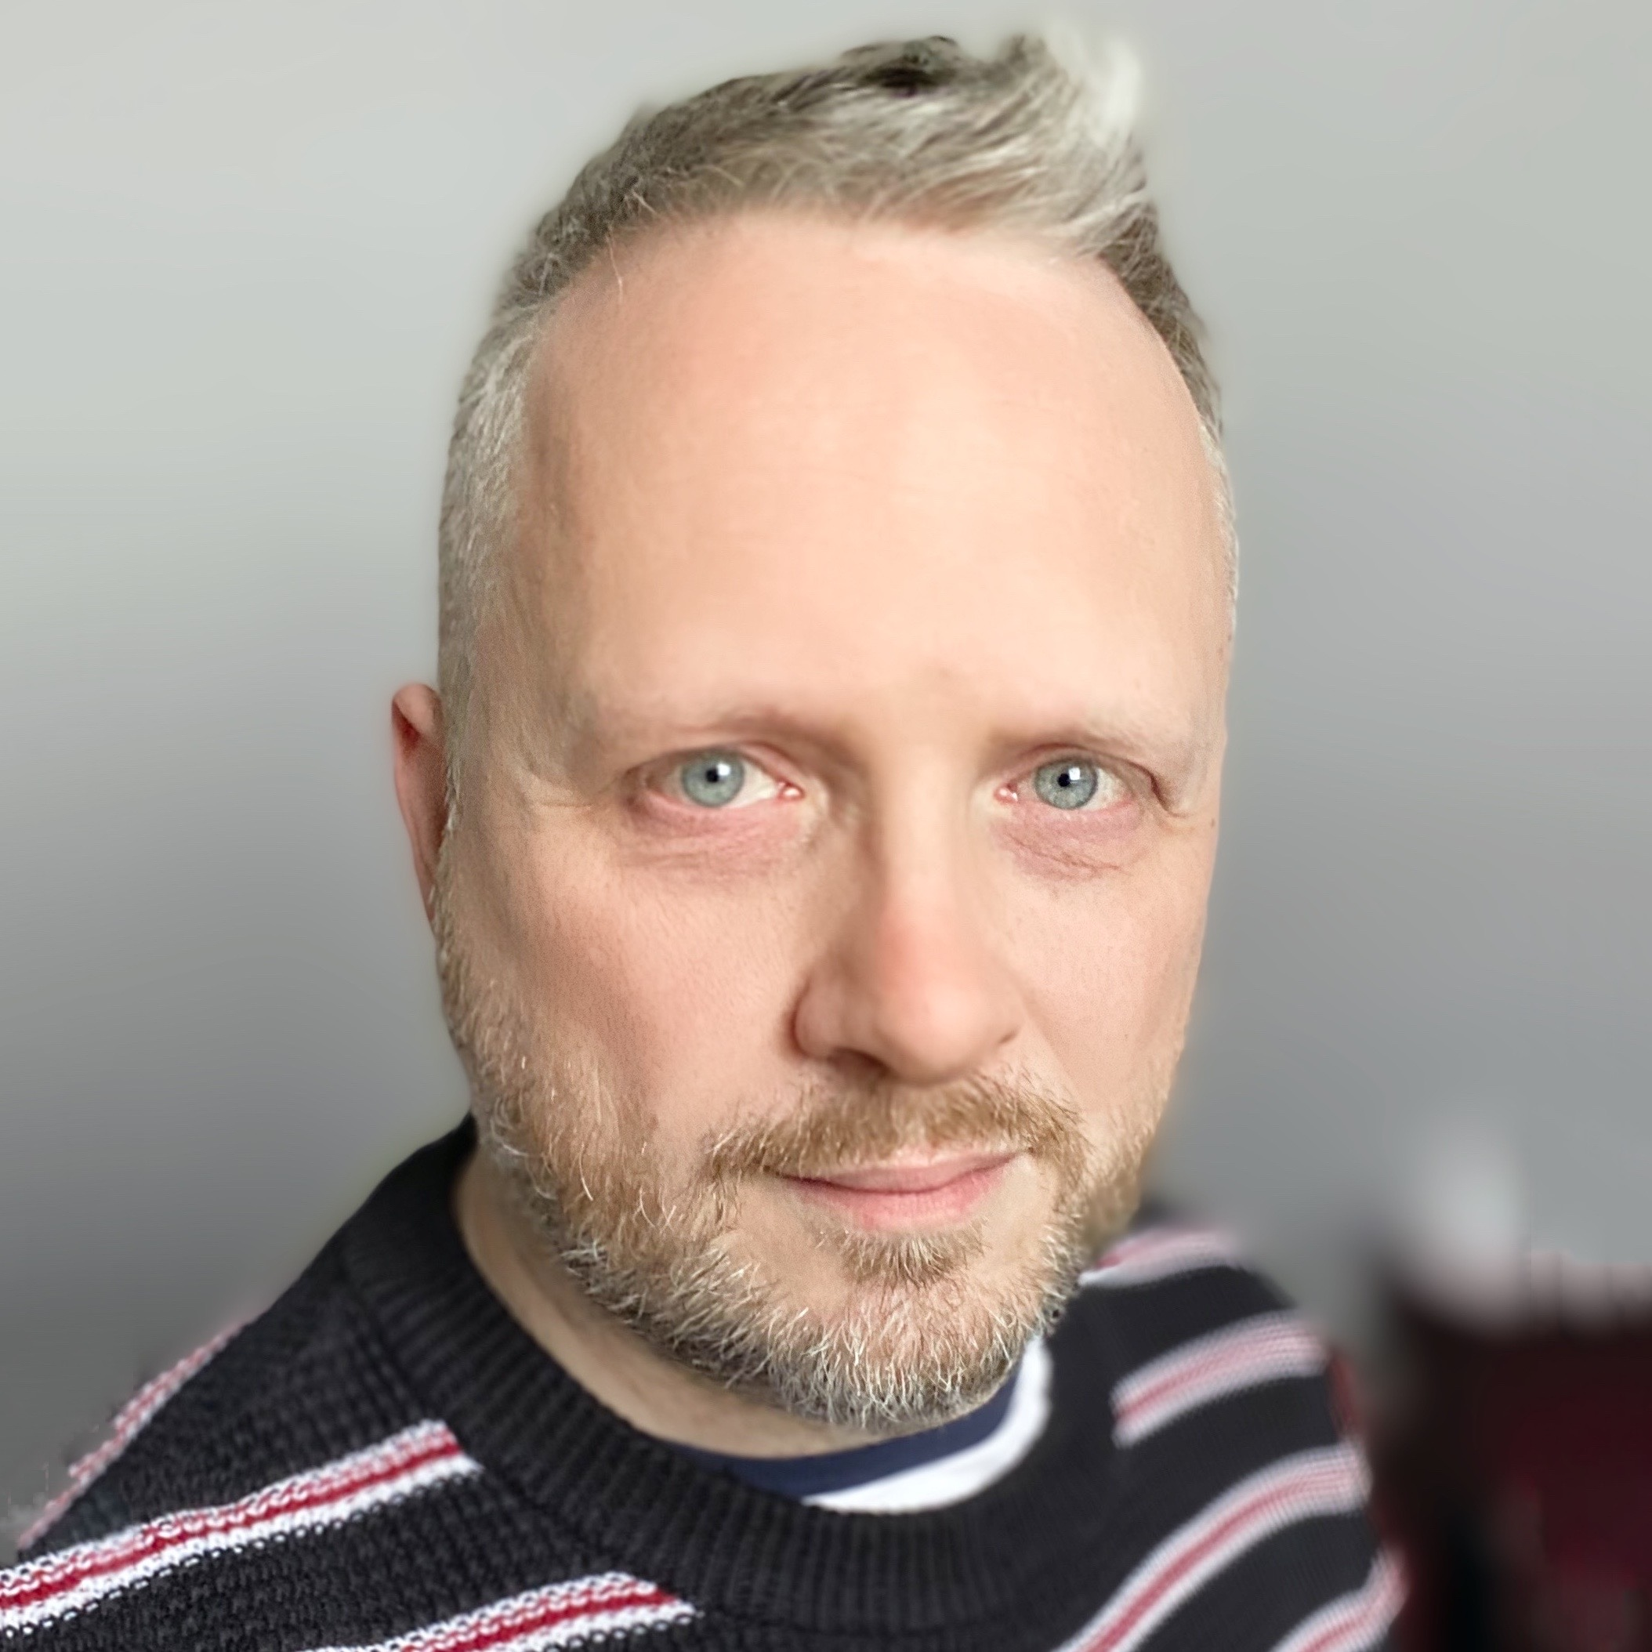
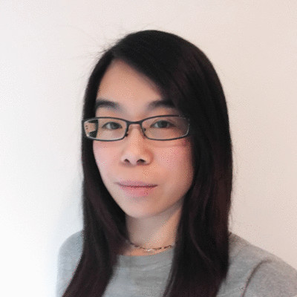
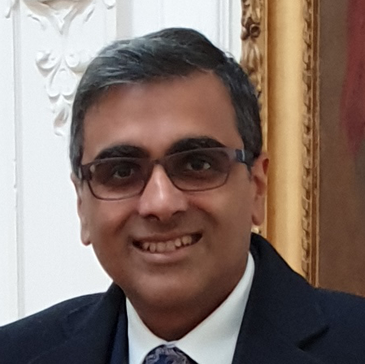
QCS Hub Support Team
Programme Management
Administration
Communications
Chris Skinner Senior Programme Manager
Nasreen Al-Hamdani Project Administration Assistant
Adi Sheward-Himpson Communications Manager
Management of hub resources
Financial oversight and reporting
Support to Directors
Management of administrative office activities
Liaison with Hub partners and administrative teams
Support to Programme Manager
Development and implementation of the Communications Strategy
Advice and assistance with communications and events
Effective communication and liaison with existing and potential supporters
User Engagement
Celia Yeung User Engagement
Dr Rupesh Srivastava User Engagement
Partnership Resource Fund
Wider engagement and introductions
Understanding the quantum computing landscape - beyond academia

